Slide 1

You Must Be Knowing Him..
Guess Who??

Slide 2

This Person Doesn’t Exist.. Father - Technology | Mother - AI That’s The Power Of Tech Today

Slide 3












Technology Is Making Our Lives Easier
Financial Services
Monetization Of Hobbies
Shopping
Entertainment
Health and Medical Services
Travel

Slide 4
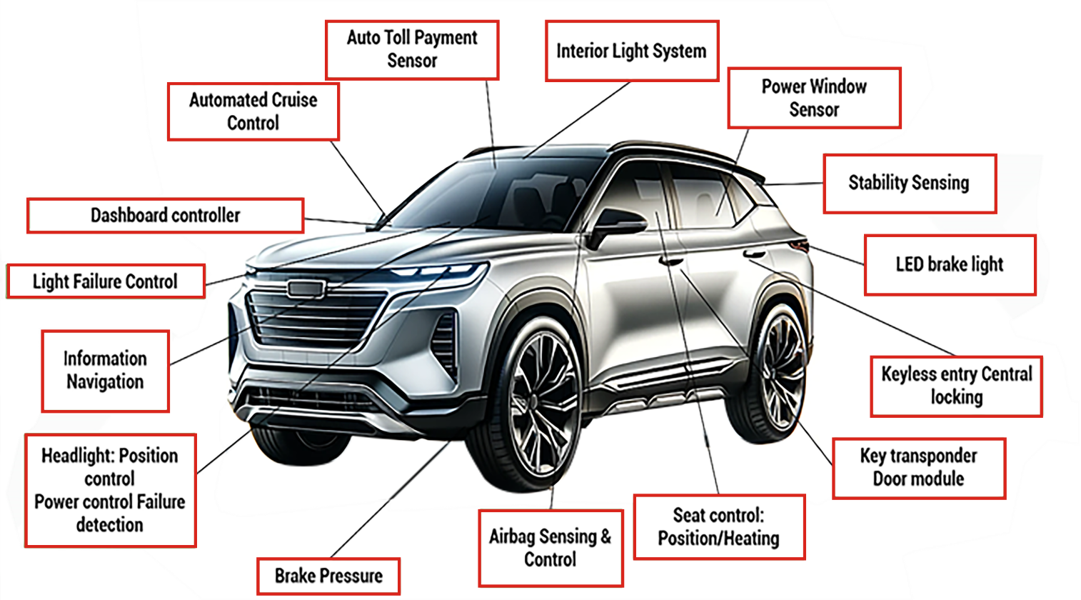

Technology Is Disrupting Products and Business
Previous Gen Car was more about
Mechanical components
Today’s Cars Require Technology As Their USP
New age cars involve complex technology with ~100mn lines of code.
This may even rise to 200-300mn lines of code in future
Source: MOFSL. These images are used for illustration purpose only

Slide 5
India IT has reinvented itself in every cycle
2009
2024
IT Services
Business Process Management
Cloud
AI
Electronic Management Services
^6 out of Top 10 IT service
companies are INDIAN
TCS
Infosys
Engineering Research & Development
Software Products
Blockchain
Fintech
Cyber Security
HCL
Wipro
E-Commerce
Telecom
Software Products
Engineering Research & Development
Business Process Management
E-Commerce
IT Services
Telecom
Tech Mahindra
LTI Mindtree
Data as on Mar-26. Source: KMAMC Internal. The stocks/sectors mentioned in this slide do not constitute any recommendation and Kotak Mahindra Mutual Fund may or may not have any future position in these sectors/stocks. Use of the company names does not imply any affiliation with or endorsement by them. The scheme does not assure or predict any specific returns or future returns. For detailed portfolio and related disclosures for the scheme(s) please refer to our website https://www.kotakmf.com/Information/forms-and-downloads The portfolio and its composition is subject to change and the same position may or may not be sustained in future. The fund manager may make the changes, as per different market conditions and in the best interest of the investors. The stocks/sectors mentioned do not constitute any kind of recommendation and are for information purpose only. Kotak Mahindra Mutual Fund may or may not hold position in the mentioned stock(s)/sector(s).
5
Notes:
Products team to update

Slide 6












Indian IT – Some interesting facts
Technology Industry: FY25 Snapshot View.
7.3%
$283 Bn
43-45%
Relative share of GDP
Tech Industry Revenue
Share in India’s Services Export
US$224.4 Bn
57-58%
$58.2 Bn
Tech Export Revenues
Share in Global Sourcing
Tech Domestic Revenues
40K+
~5.8 Mn
32-35K
Tech Firms in India
Talent in the Tech Industry
Tech StartUps in India
36%
1750+
90k
Women in Tech Industry
Global Capability Centers (GCCs) in India
Tech Patents Filed in India in CY24
Source: NASSCOM Strategic Review 2025. This is the latest data available
6

Slide 7
FY26: India technology industry performance
6.1% growth
Source: NASSCOM Strategic Review 2026. This is the latest data available. The stocks/sectors mentioned in this slide do not constitute any recommendation and Kotak Mahindra Mutual Fund may or may not have any future position in these sectors/stocks.

Slide 8
US among geographies and financials are the biggest clients of Indian IT
Growth markets: USA and APAC
Growth verticals: BFSI, Retail
Exports by Geography % share
Exports by Sector % share
²
100%
=
245.9 Bn³
100%
=
224 Bn³
² Includes travel and transportation, construction and utilities, media, publishing, and entertainment
³ Includes IT services, BPM, Software products, ER&D and excludes hardware
Data as on FY 25. This is the latest data available. Source: Nasscom
8

Slide 9
Structural Growth Has Remained Good
Overall IT Spending
Growth %
GFC
Source: Gartner, Nasscom Strategic Review 2026 | This is the latest data available

Slide 10
IT Sector Looks Fundamentally Strong
Consistent EBIT Margin
Stable ROE
Strong Cash flows
High Dividend Payouts
* Including Buyback. The above data is the average of the TOP 5 IT companies. Data as on FY’25 , Source: KMAMC Internal Research. This is the latest data available.
Notes:
Require updated data

Slide 11
Services’ share within overall tech spend could expand
E
Source: Gartner estimates, Bernstein estimate & analysis, As on 14th July 2025, E stands for Estimates, As per latest data available. The stock(s)/sector(s) mentioned in this slide do not constitute any recommendation and Kotak Mutual Fund may or may not have any future position in these stock(s) & sectors(s)

Slide 12

It is a myth that software engineering is only about coding
Hardly one sixth of a software engineer’s time is spent on coding
Coding
16%
Requirements, Tests
14%
Security
13%
Implementing Processes
12%
Management, Performance
12%
Deployment
12%
Where are coders spending their time?
Infra Management
11%
User Experience
10%
Source: IDC Report, Bernstein Analysis, As per latest available data

Slide 13
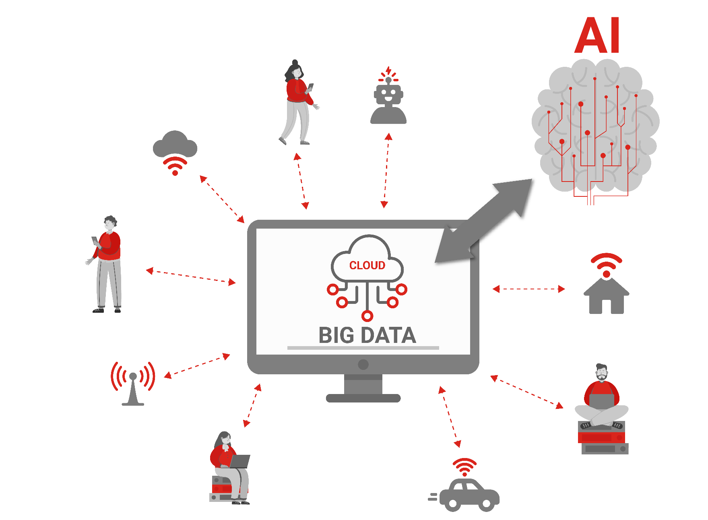

Data Is The New Oil..

Slide 14
Scope for higher 5G adoption in India
 |  | USA | China | EU | India | India (2030) | Growth | (CAGR / Change)
Internet User (Mn. People) |  | 317 | 1,142 | 486 | 836 | 982 | 3% | ↗
Penetration (%) |  | 93% | 80% | 90% | 58% | 65% | 7% | ❐
Smartphones (Mn. People) |  | 289 | 1,105 | 471 | 550 | 696 | 4% | ↗
Penetration (%) |  | 85% | 77% | 92% | 38% | 46% | 8% | ❐
Mobile data per month per smartphone (GB) |  | 22 | 25 | 19 | 25-30 | 30-35 | 5-6% | ↗
Mobile data per month (EB)* |  | 8 | 38 | 10 | 24 | 30-35 | 9% | ↗
5G Penetration |  | 71% | 55% | 30% | 29% | 50% | 21% | ❐
Cost of Data/GB |  | 5.62 | 0.41 | 0.79 | 0.17
Avg Wireless Data Usage/Wireless data subscriber/Month
317
1,142
486
836
982
3%
↗
93%
80%
90%
58%
65%
7%
❐
2GB YoY increase every year since Mar-19
289
1,105
471
550
693
4%
↗
Widespread adoption of Smartphones
85%
77%
92%
38%
46%
8%
❐
22
25
19
25-30
30-35
5-6%
↗
Consumption below <1GB/month
8
38
10
24
30-35
9%
↗
71%
55%
30%
29%
50%
21%
❐
Mar-30E
5.62
0.41
0.79
0.17
↗ CAGR
❐ Change
Source: GSMA, Ericsson, Kantar, CNNIC, IAMAI, Avendus Spark Estimates
Source: TRAI, Avendus Spark Estimate
* Mobile data per month used for USA is NA, for China it is North East Asia, For EU it is West Europe & for India it is India/Nepal/Bhutan | Details are as per latest data available
14

Slide 15






AI to be a key structural demand driver going ahead
CATEGORY
Hardware/
Networking/
Memory
Software
Internet
Semis
Power
Cooling
2028 AI
SPENDING
$401B
$94B
$174B
$250B
$84B
$26B
2025 AI
SPENDING
$59B
$94B
$174B
$116B
$23B
$11B
Source: Morgan Stanley Research and estimates, B stands for Billion
15

Slide 16
Internet Market Opportunity Is Huge In India
Internet Market Size in India sees exponential growth
Quick Commerce is re-defining retail
Source: Bessemer Venture Partners, https://www.ibef.org/industry/ecommerce ; https://assets.kpmg.com/content/dam/kpmg/pdf/2014/11/BBG-Retail.pdf; https://www.statista.com/statistics/935872/india-retail-market-size/
#
Source: statista, Bessemer Venture Partners

Slide 17
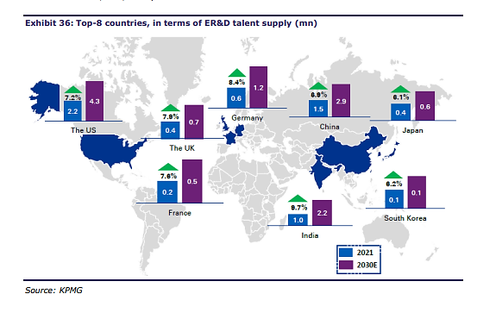
Other Tech Segments Also See Rising Opportunities
India is One of the few countries providing ER&D talent supply^
India sees huge potential in the EMS Market@
Global Electronic Market
USD2.5t
Global EMS Market
USD880b
USA
USD140b
(16%)
Europe
USD58b
(7%)
China
USD441b
(47%)
India
USD20b
(2%)
Others
USD251b
(29%)
50 Years Younger UPI* Competing Major Fintech Giant
Launched in 1966
Launched in 2016
Source: ^KPMG. Data as on CY 21, *NPCI , data for Dec-25. @Frost & Sullivan, MOFSL Research, as on Oct-23 . This is the latest data available

Slide 18

Kotak Technology Fund
An open ended equity scheme investing in Technology & technology related Sectors

Slide 19
Investment Approach
Kotak Technology Fund
Bottom-Up Approach
Identify Companies With BMV Approach From A Selected Sector
Stock Selection
Selection Of Companies Showing Growth At Reasonable Price
No Cap On Market Cap
Flexibility To Buy Across All Market Cap Segments
Participation In Growth Potential
Investment In The Potential Growth Story Of Technology Sector
Investment Universe
Suitable Top Ideas To Be Selected By In-house Research

Slide 20



Why Tech Now?
We believe enterprise AI adoption could be a medium to long term tailwind for the sector
Agentic AI requires lot more customization, increasing scope of work for services sector
Precursor and adjacencies for IT spends like data and cloud could witness demand tailwinds
Technology Tailwinds
Weak and uncertain macro in US and EU led to hold back of technology spends for prior 3 years
With macro improving in the Western economies, we expect demand recovery over FY27-28
Sharp INR depreciation could boost the earnings in the near term.
Macro recovery
Adjusted for the high growth in the post Covid era, PE multiples are potentially attractive in many cases
Valuations of the sector in many cases are below long-term averages
Reasonable valuations
The stock(s)/sector(s) mentioned in this slide do not constitute any recommendation and Kotak Mutual Fund may or may not have any future position in these stock(s) & sectors(s)

Slide 21


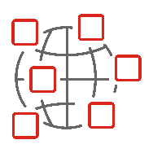



Broad Investment Universe
Includes IT management, software, consulting, outsourcing companies
Includes networking, wireless, and wireline services, equipment and support;
IT services
Telecommunications
Includes consumer tech, Fintech, e-retail/e-commerce technology platforms, IoT
Includes the distribution of information and content providers
Internet technology enabled services
Media and information services
Includes hardware computers, electronic technology and electronic components
AI. Electronic Manufacturing Services (EMS) & IT Infrastructure
IT products
Others
Asset allocation will be at the discretion of the Fund Manager. For further details refer SID

Slide 22
Portfolio Holdings ( as of 31st March,2026)
Top 10 Stocks | Net Asset %
Infosys Ltd. | 19.82%
Bharti Airtel Ltd | 17.71%
Tech Mahindra Ltd. | 6.81%
Tata Consultancy Services Ltd. | 6.76%
ETERNAL LIMITED | 6.13%
PERSISTENT SYSTEMS LIMITED | 4.29%
HCL Technologies Ltd. | 3.76%
BHARTI HEXACOM LTD. | 3.75%
Mphasis Ltd | 3.41%
Indus Towers Ltd. | 3.37%
Top 5 Sectors | Net Asset %
Information Technology | 56%
Telecommunication | 25%
Consumer Services | 14%
Services | 2%
Consumer Durables | 2%
Source: KMAMC Internal, Factsheet. For detailed portfolio and related disclosures for the scheme(s) please refer to our website https://www.kotakmf.com/Information/forms-and-downloads The portfolio and its composition is subject to change and the same position may or may not be sustained in future. The fund manager may make the changes, as per different market conditions and in the best interest of the investors. The stocks/sectors mentioned do not constitute any kind of recommendation and are for information purpose only. Kotak Mahindra Mutual Fund may or may not hold position in the mentioned stock(s)/sector(s).

Slide 23
Salient Features
Feature Description | Feature Description
Name Of The Scheme | Kotak Technology Fund
Type of Scheme | An open-ended equity scheme investing in Technology & technology related sectors
Category | Equity Schemes – Sectoral Fund
Investment Objective | The investment objective of the scheme is to generate long-term capital appreciation from a portfolio that is invested predominantly in equity and equity related securities of Technology & technology related sectors. However, there is no assurance that the objective of the scheme will be achieved.
Benchmark Index | BSE Teck Index (Total Return Index)
Asset Allocation#
Fund Manager | Ms. Shibani Sircar Kurian is the fund manager for equity investment of the scheme. Mr. Abhishek Bisen will be the Fund Manager for debt investment of the Scheme.
Exit Load | For redemption / switch out within 30 days from the date of allotment: 0.5% If units are redeemed or switched out on or after 30 days from the date of allotment: NIL Any exit load charged (net off Goods and Services tax, if any) shall be credited back to the Scheme. Units issued on reinvestment of IDCWs shall not be subject to entry and exit load.
Minimum Purchase Amount | Initial Purchase (Non- SIP)- Rs. 100/- and any amount thereafter Additional Purchase (Non- SIP)- Rs. 100/- and any amount thereafter SIP Purchase- Rs. 100/- and any amount thereafter
Instruments | Indicative allocations (% of total assets)
 | Minimum | Maximum
Equity and Equity Related Securities of technology & technology related sectors | 80 | 100
Equity and Equity Related Securities Other than technology & technology related sectors | 0 | 20
Debt and Money Market Securities | 0 | 20
Units of REITs & InvITs | 0 | 10
#For detailed asset allocation and scheme information, please refer the scheme information document (SID)

Slide 24

Fund Manager Of Kotak Technology Fund
Ms. Shibani Kurian - Fund Manager & Head- Equity Research
Business Experience:
20+ years Industry Experience in Indian Equity Markets
With Kotak Mahindra AMC for more than 15 years

Slide 25
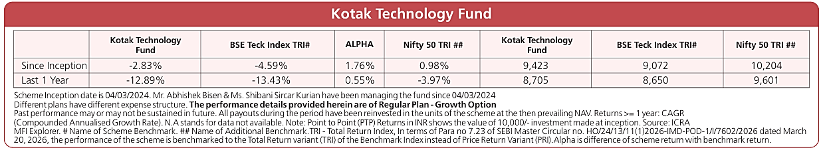
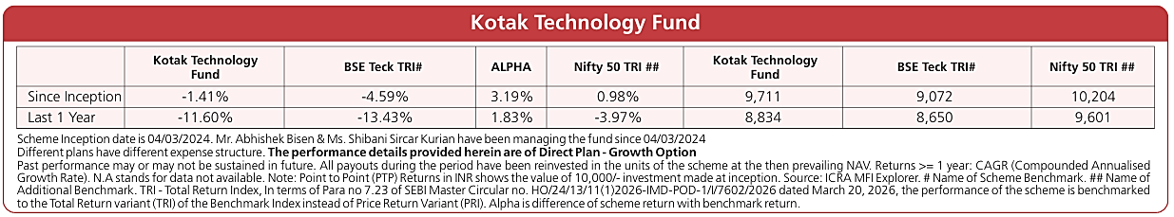
Scheme Performances as on 31st March,2026
KOTAK TECHNOLOGY FUND
An open-ended equity scheme investing in Technology & technology related Sectors.
.
Regular Plan
PERFORMANCE
Direct Plan
PERFORMANCE

Slide 26
Click To Invest
Investors should consult their financial advisers if in doubt about whether the product is suitable for them.

Slide 27
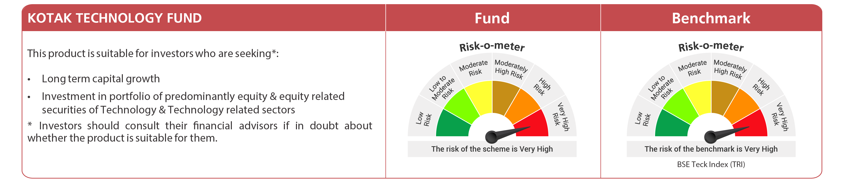
Riskometer
Kotak Technology Fund
An open ended equity scheme investing in Technology & technology related Sectors
For latest Riskometer, investors may refer to an addendum issued or updated on website at www.kotakmf.com

Slide 28
Disclaimers
The information contained in this (document) is extracted from different public sources/KMAMC internal research. All reasonable care has been taken to ensure that the information contained herein is not misleading or untrue at the time of publication. This is for the information of the person to whom it is provided without any liability whatsoever on the part of Kotak Mahindra Asset Management Co Ltd or any associated companies or any employee thereof. Investors should consult their financial advisors if in doubt about whether the product is suitable for them before investing.
The document includes statements/opinions which contain words or phrases such as "will", "believe", "expect" and similar expressions or variations of such expressions, that are forward looking statements. Actual results may differ materially from those suggested by the forward looking statements due to risk or uncertainties associated with the statements mentioned with respect to but not limited to exposure to market risks, general and exposure to market risks, general economic and political conditions in India and other countries globally, which have an impact on the services and/or investments, the monetary and interest policies of India, inflation, deflation, unanticipated turbulence in interest rates, foreign exchange rates, equity prices or other rates or prices etc.
This is not intended for distribution or use by any person in any jurisdiction where such distribution would be contrary to local law or regulation. The distribution of it, in certain jurisdictions may be restricted or totally prohibited and accordingly, persons who come into possession of this material are required to inform themselves about, and to observe, any such restrictions. The sector(s)/ stock(s) referred, if any should not be construed as any kind of recommendation and are for information/used to explain the concept.
Past performance may or may not be sustained in future. For more details visit www.kotakmf.com. For detailed portfolio and related disclosures for the scheme(s) please refer our website https://www.kotakmf.com/Information/forms-and-downloads. The portfolio and its composition is subject to change and the same position may or may not be sustained in future. The fund manager may make the changes, as per different market conditions and in the best interest of the investors. To view the latest complete performance details of the Scheme(s) kindly refer to the factsheet on our website https://www.kotakmf.com/Information/forms-and-downloads.
Investors may consult their financial expert before making any investment decision.
Mutual Fund investments are subject to market risks, read all scheme related documents carefully.

Slide 29
